Slide 1

Twitter Sentiment Analysis
Natural Language Processing
Brennan Mathis

Slide 2
Problem Statement
Find a method to assess consumer sentiment toward product or brand using public tweets and language contained within tweets without individually assessing tweet

Slide 3

Business Value
By providing sentiment analysis information obtained through tweets, informed decisions can be made implementing policy to continue positive sentiment or execution of corrective action in the case of negative sentiment.
Notes:
Dataset specific to apple & android products, so brand names removed from tweets to remove bias toward product sentiment using only the language toward brand and product to analyze sentiment so useful for any brand.

Slide 4
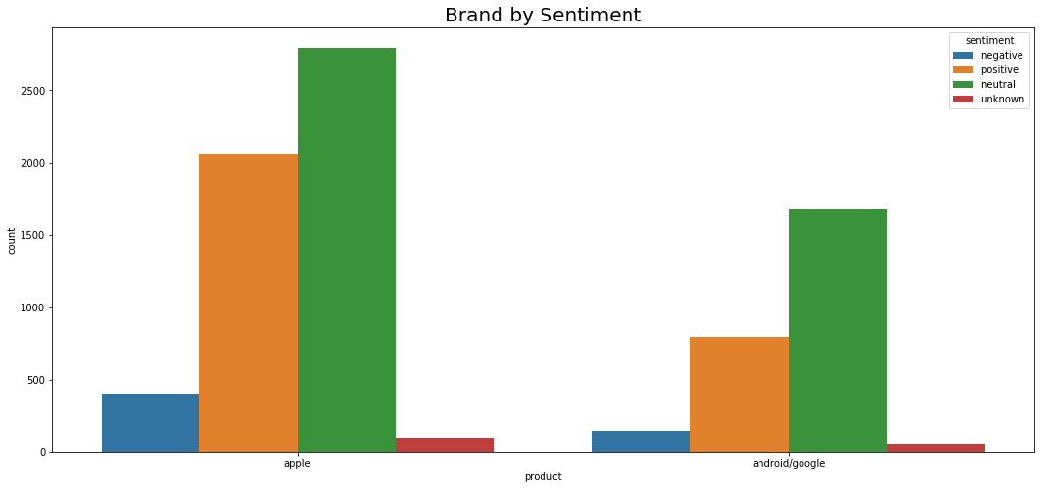
Factors Assessed
Tweets regarding specific technology based companies and their products(Apple & Android/Google)
Term frequency and relativity
Combinations of words(n-grams)
Notes:
Removed brand and product terms from tweets using stopwords removal for this as I was assessing the language toward the
Sentiment only, but this could be used to filter sentiment toward a specific product for a company releasing new products or
Performing customer satisfaction promises by listening to consumers
there were far more apple and apple product references in this dataset than android

Slide 5
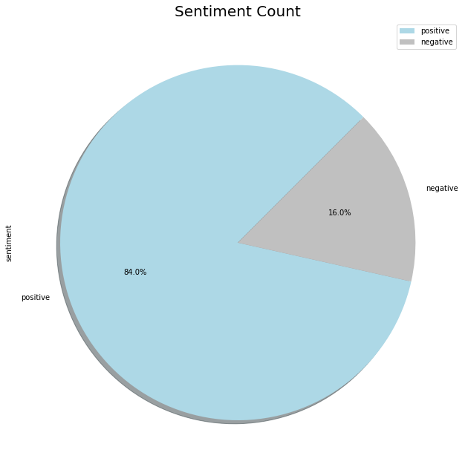
Dataset Info
3392 tweets
5059 unique words/tokens
Notes:
Data was from sxsw in Austin
Removed those terms ‘
Many overlapping terms existed s show later
Max length of tweets – 17 words

Slide 6
PCA on Dataset

Slide 7
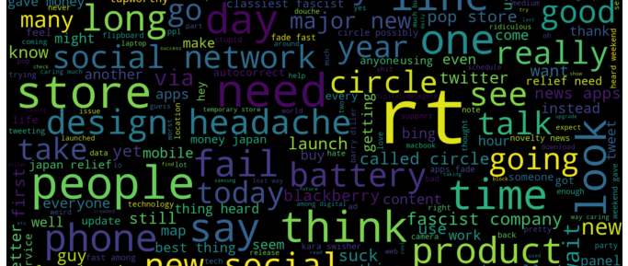
Negative terms
Notes:
Top 50 terms in negative tweets
Overlapping data frequently occurring in positive & negative sentiment

Slide 8
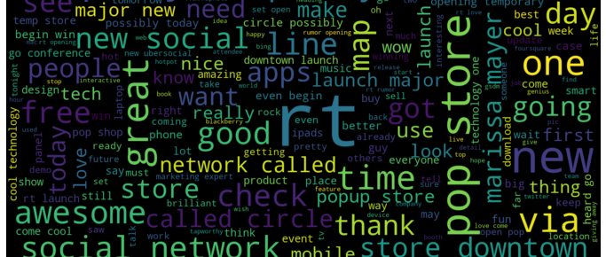
Positive terms
Notes:
Top 50 terms in positive tweets
Overlapping data frequently occurring in positive & negative sentiment
Examples include social network, store, rt

Slide 9
Methodology
Word Embeddings
Word Frequency
Bayes Theorem
Random Forest
K Nearest Neighbors
88% accuracy
Notes:
Word embeddings neural network-
Accuracy: 0.867452
Precision: 0.896040
Recall: 0.952632
F1 score: 0.923469
ROC AUC: 0.801585
[[ 46 63]
[ 27 543]]
Word frequency neural networks:
Unaltered data using class weights-
Accuracy: 0.883652
Precision: 0.891547
Recall: 0.980702
F1 score: 0.934002
ROC AUC: 0.830839
[[ 41 68]
[ 11 559]]
SMOTE balanced data-
Accuracy: 0.880707
Precision: 0.896272
Recall: 0.970175
F1 score: 0.931761
ROC AUC: 0.822195
[[ 45 64]
[ 17 553]]
Statistical methods used
Bayes – Test Accuracy: 0.85 [ 5, 104],
[ 1, 569]
Random Forest – Test Accuracy: 0.87 [ 25, 84],
[ 3, 567]
KNN - Test Accuracy: 0.86 [ 32, 77],
[ 18, 552]]

Slide 10
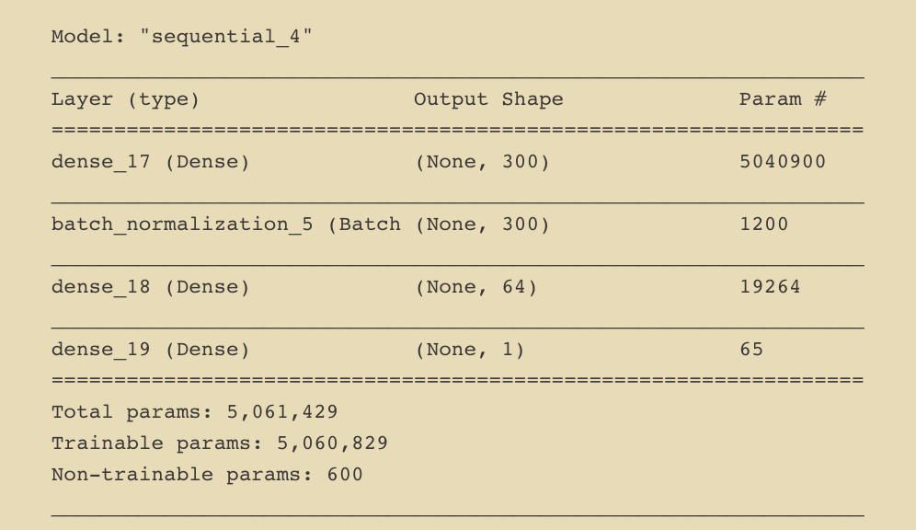
Training & Validation Loss/Accuracy

Slide 11
Business Recommendations
Keep up with trends
Stay competitive
Predict & plan ahead
Collect more data
Notes:
Determine product trends and keep up with current needs
Assess competitor’s popularity and determine the why and how to stay competitive
Predict and plan according to consumer reactions
Collect variety of tweets for variety of related brands, products, events to produce a more accurate model
Maintain a presence on social media to show consumers that you care and hear them, and address their concerns verbally and through followup action

Slide 12
#Thankyou

